Slide 1

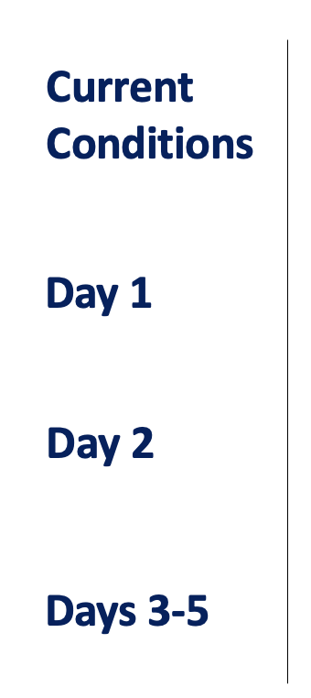
CPEX-CV Forecast
September 1, 2022
Lead name, Support name, Support Name, Support Name
XXX.
XXX.
XXX.
XXX.

Slide 2
Forecast Post-mortem for Yesterday
How did the forecast from 2 days ago perform for yesterday?
Dust and Aerosols (SAL):
AEWs:
Convection:

Slide 3
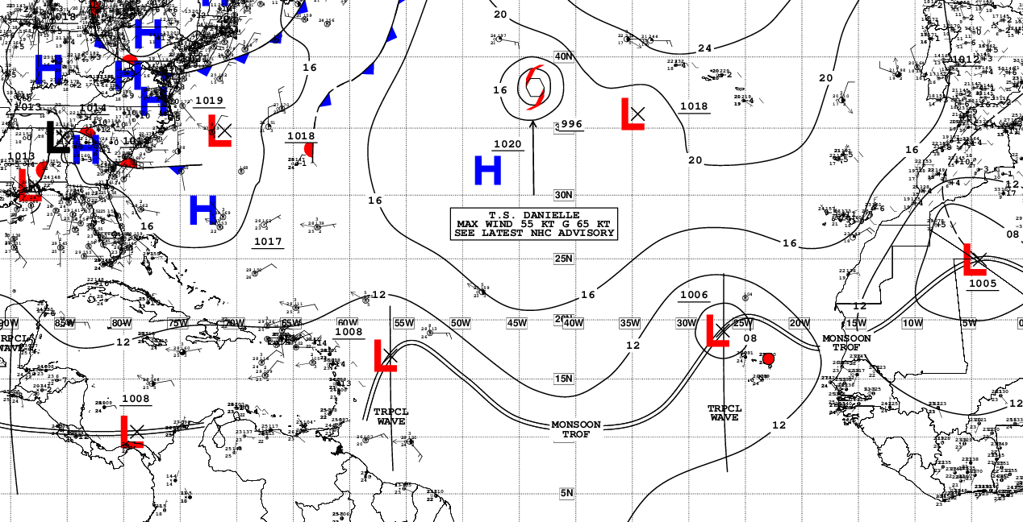
Current Conditions – Synoptic View
NHC Surface Analysis (XXZ)
…
…

Slide 4
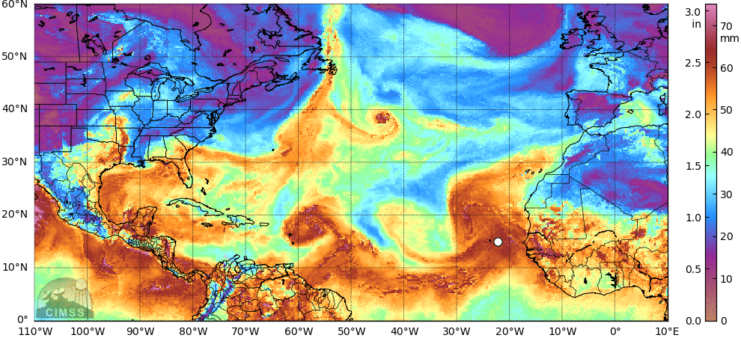
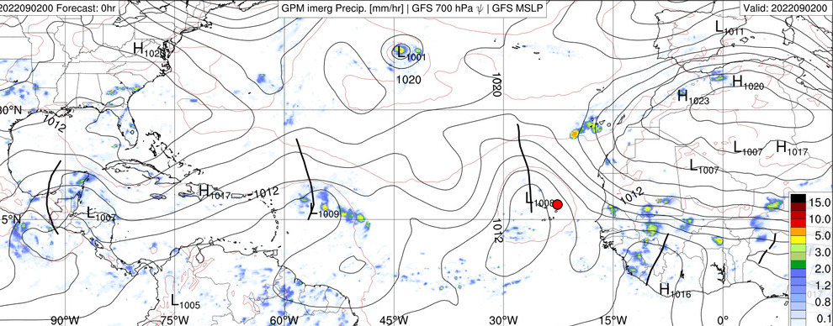
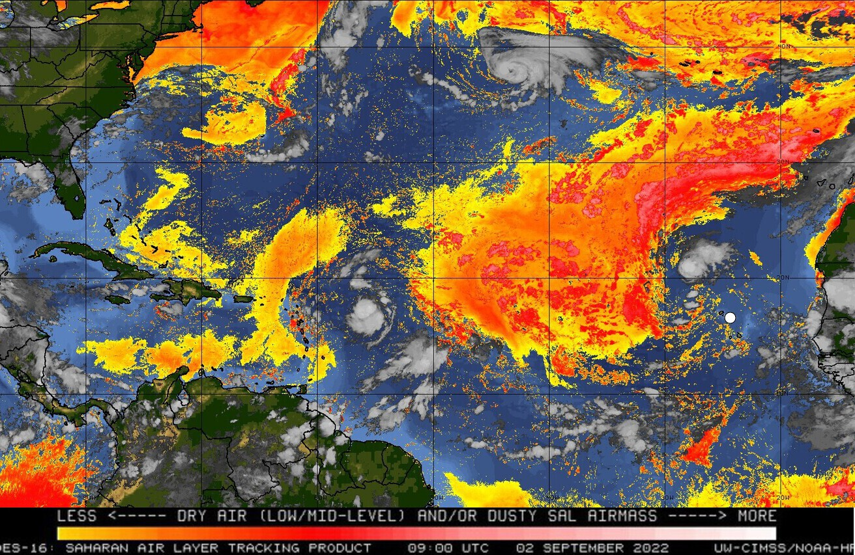
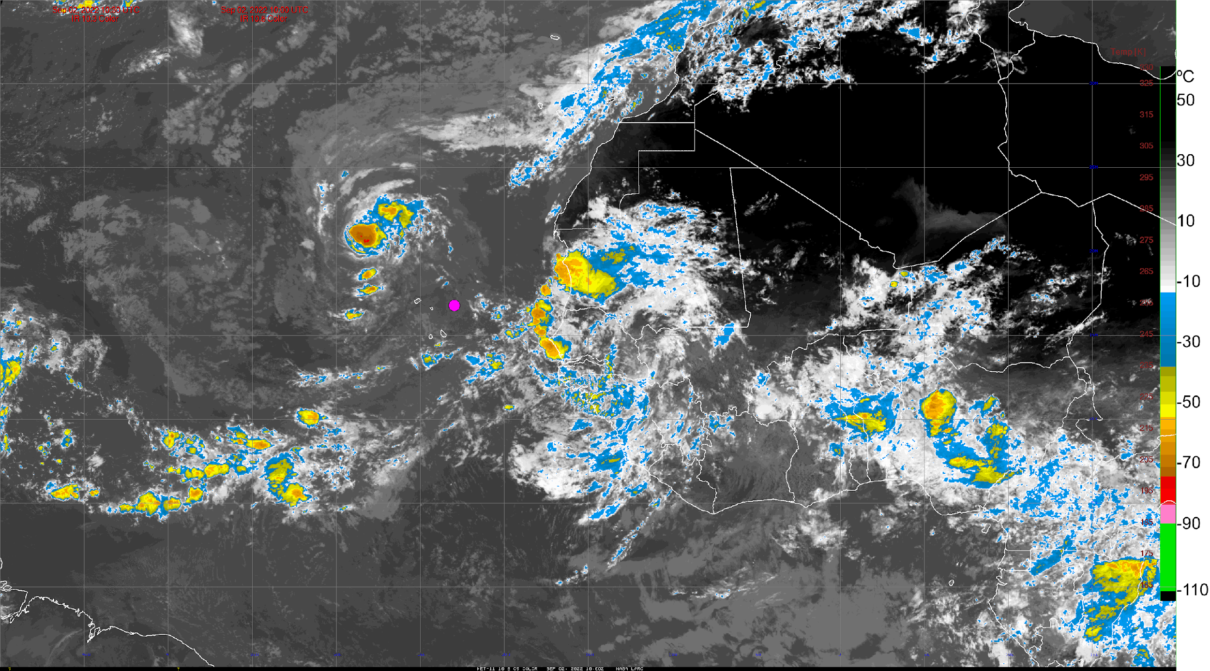
Current Conditions – AEWs, SAL, Satellite IR
Total Precipitable Water (XXZ) – MIMIC
IMERG Rain Rate, MSLP, AEWs (XXZ) – GFS
SAL (split window, XXZ) – GOES-16
GOES-16 / Meteosat-11 IR (XX:XXZ)

Slide 5
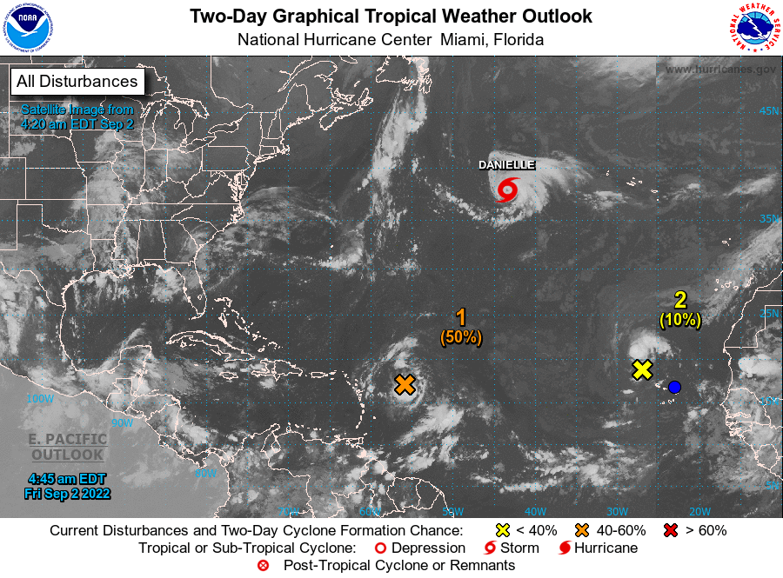
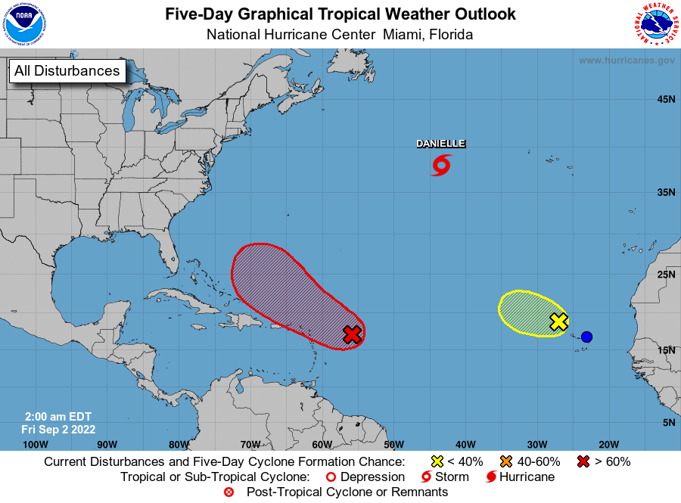
NHC Tropical Atlantic Outlook
(Sept. 3 & Sept. 6, 2022)
2-day Outlook
5-day Outlook
…

Slide 6
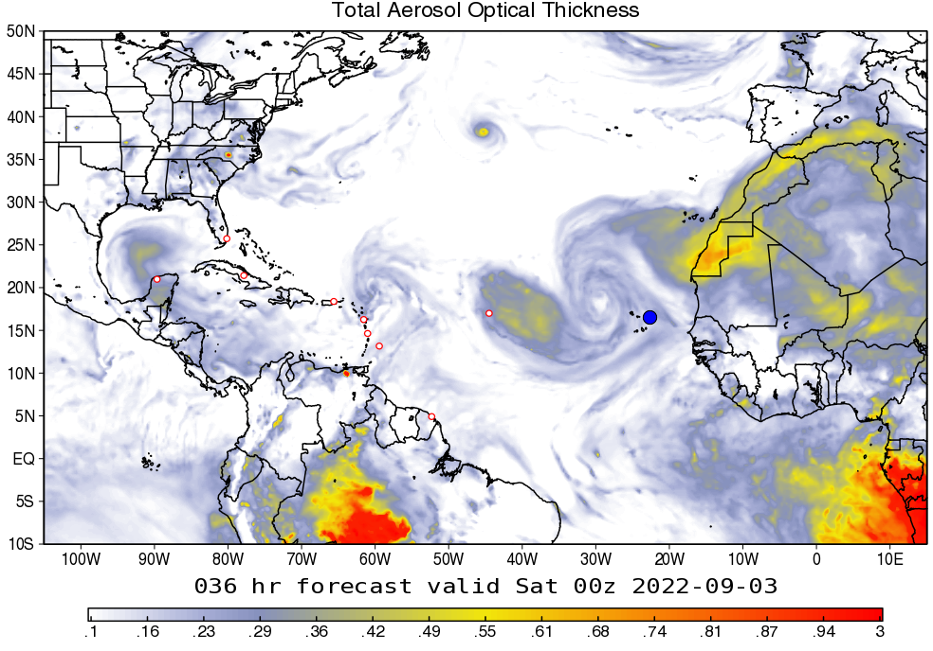
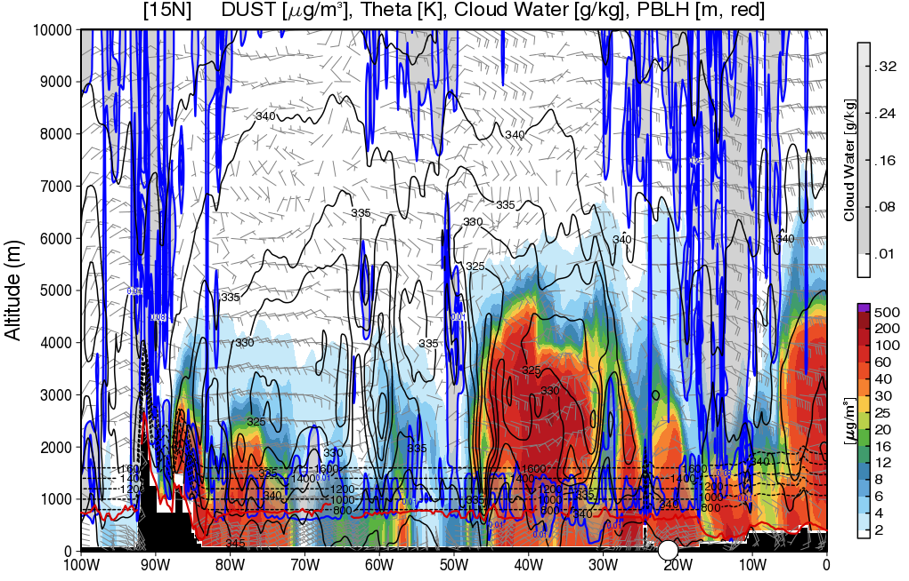
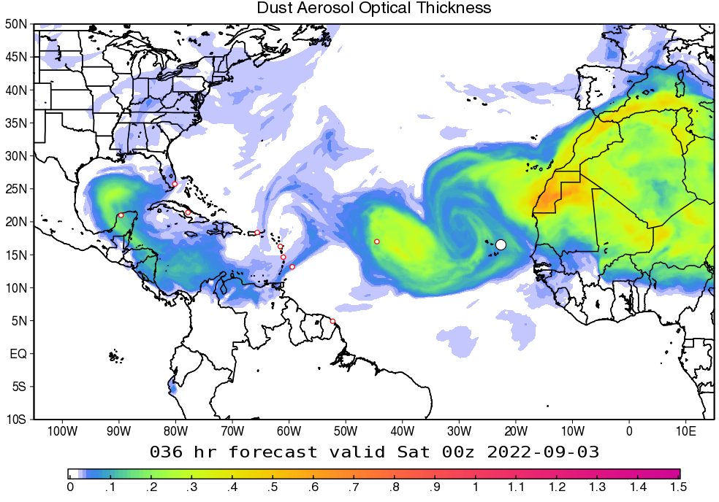
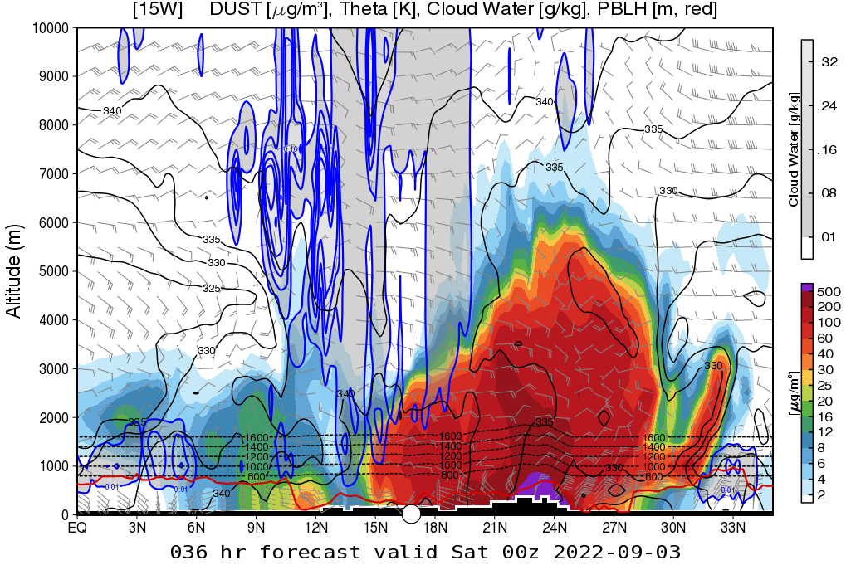
Dust and Aerosols – Day 1
(Sept. 2, 2022)
Total AOT – GEOS
Dust cross-section at 15°N
…
Dust AOT – GEOS
Dust cross-section at 20°W

Slide 7
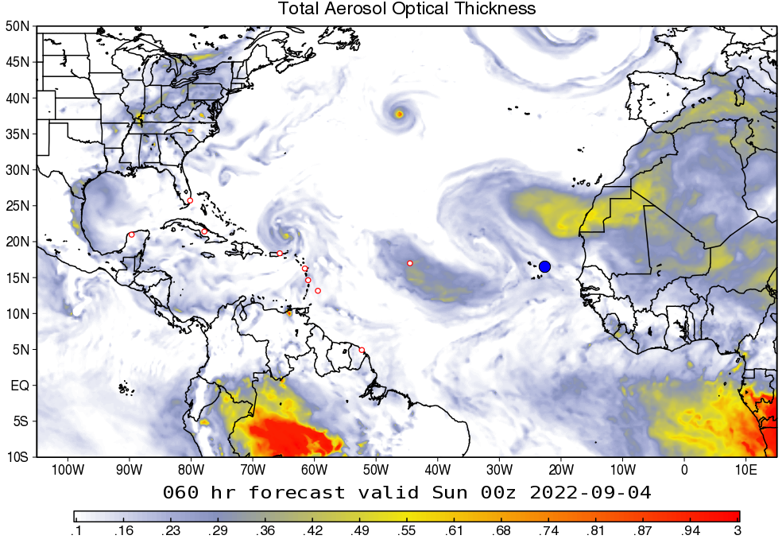
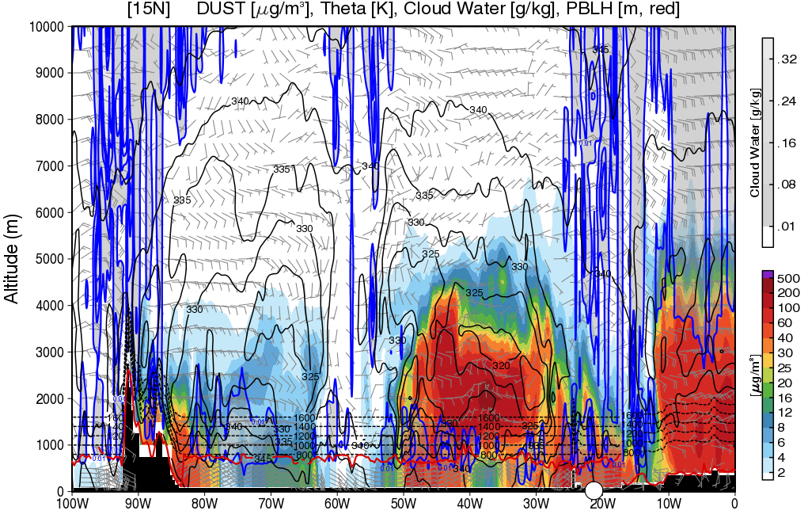
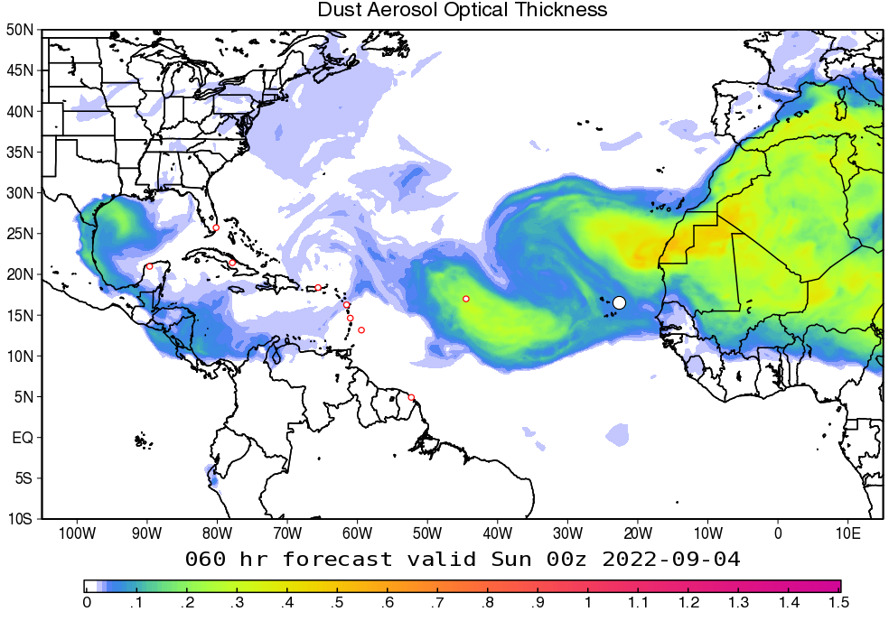
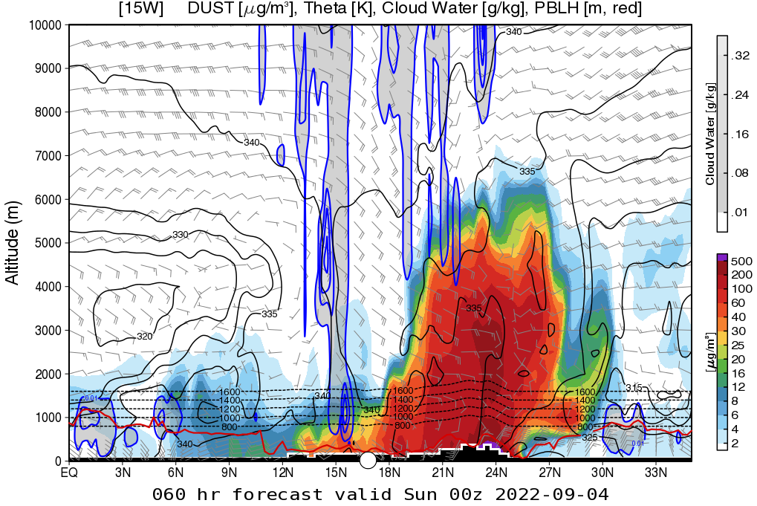
Dust and Aerosols – Day 2
(Sept. 3, 2022)
Total AOT – GEOS
Dust cross-section at 15°N
…
Dust AOT – GEOS
Dust cross-section at 20°W

Slide 8
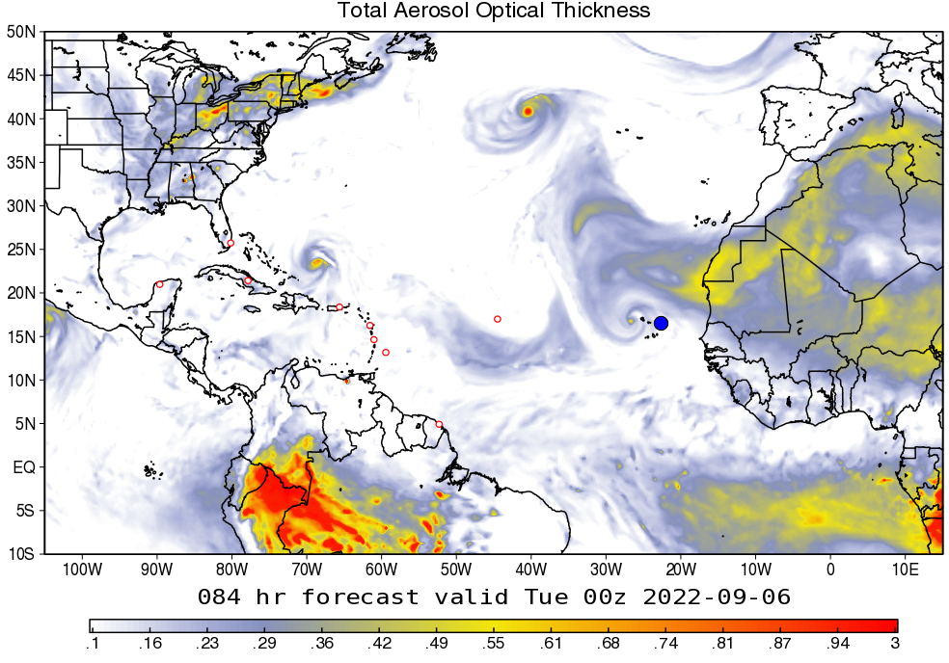
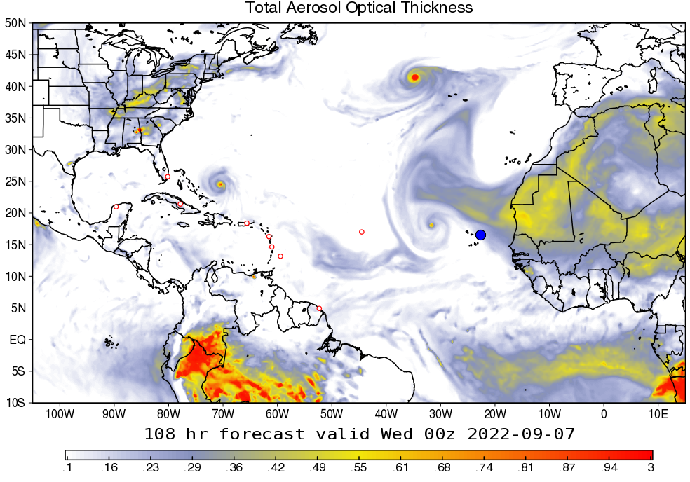
Dust and Aerosols – Days 3 & 4
(Sept. 4 & 5, 2022)
Ensemble Mean Total AOT – GEOS (day 3)
Ensemble Mean Total AOT – GEOS (day 4)
…

Slide 9
Dust and Aerosols – Forecast Tendency
Day 1 (Sept. XX):
Day 2 (Sept. XX):
Day 3 (Sept. XX):

Slide 10
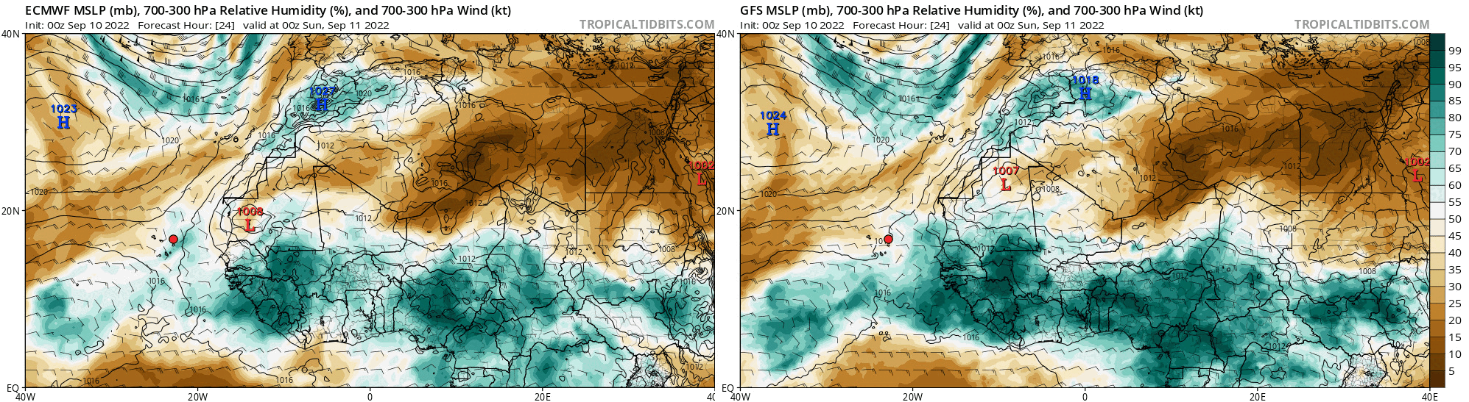
Forecast – AEWs (day 1)
(Sept. 2, 2022)
MSLP, 700-300mb RH, and 700-300mb Winds – ECMWF
MSLP, 700-300mb RH, and 700-300mb Winds – GFS
…

Slide 11
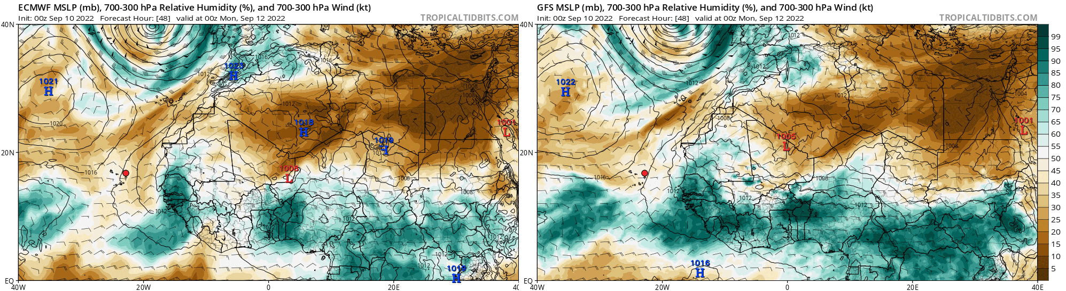
Forecast – AEWs (day 2)
(Sept. 3, 2022)
MSLP, 700-300mb RH, and 700-300mb Winds – ECMWF
MSLP, 700-300mb RH, and 700-300mb Winds – GFS
…

Slide 12
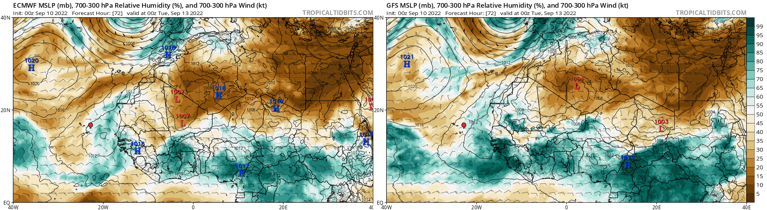
Forecast – AEWs (days 3-5)
(Sept. 4 – Sept. 6, 2022)
MSLP, 700-300mb RH, and 700-300mb Winds – ECMWF
MSLP, 700-300mb RH, and 700-300mb Winds – GFS
…

Slide 13
AEWs – Forecast Tendency
Day 1 (Sept. XX):
Day 2 (Sept. XX):
Days 3-4 (Sept. XX – XX):

Slide 14
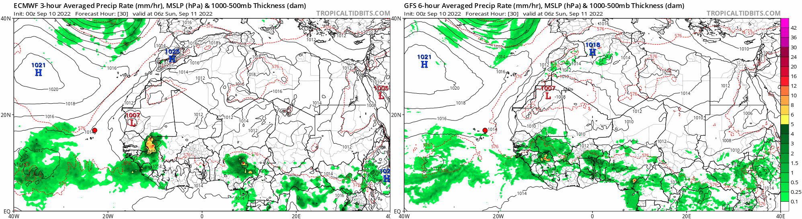
Forecast – Convection (day 1)
(Sept. 2, 2022)
MSLP, Rain Rate, 1000-500mb Thickness – ECMWF
MSLP, Rain Rate, 1000-500mb Thickness – GFS
…

Slide 15
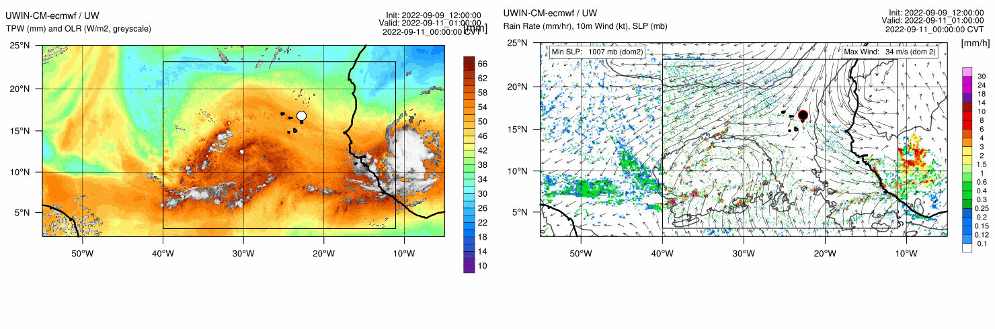
Forecast – Convection (day 1)
(Sept. 2, 2022)
TPW, OLR – UWIN-CM
10m Winds, MSLP, Rain – UWIN-CM
…

Slide 16
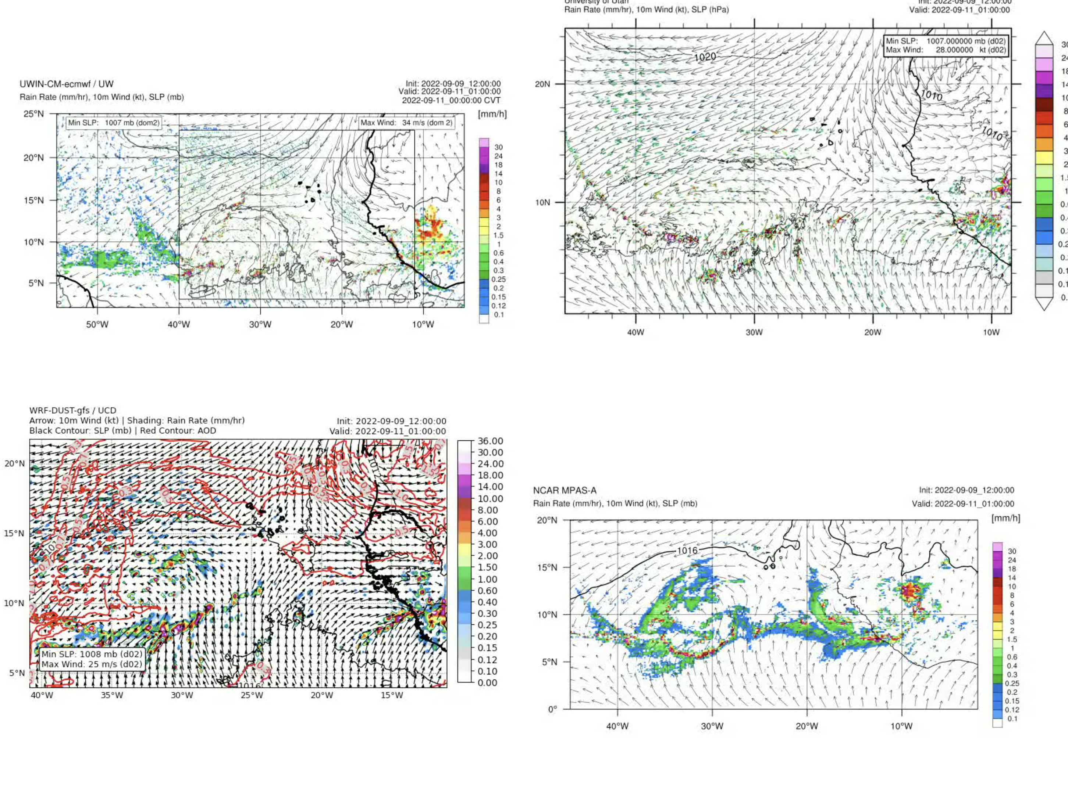
Forecast – Convection (day 1)
(Sept. 2, 2022)
…

Slide 17
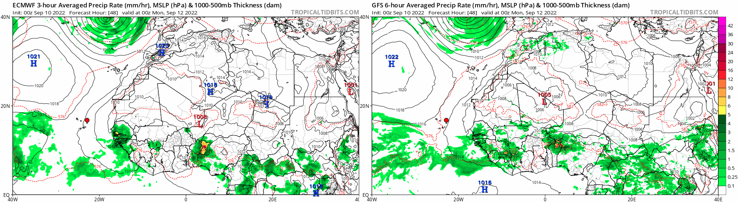
Forecast – Convection (day 2)
(Sept. 3, 2022)
MSLP, Rain Rate, 1000-500mb Thickness – ECMWF
MSLP, Rain Rate, 1000-500mb Thickness – GFS
…

Slide 18
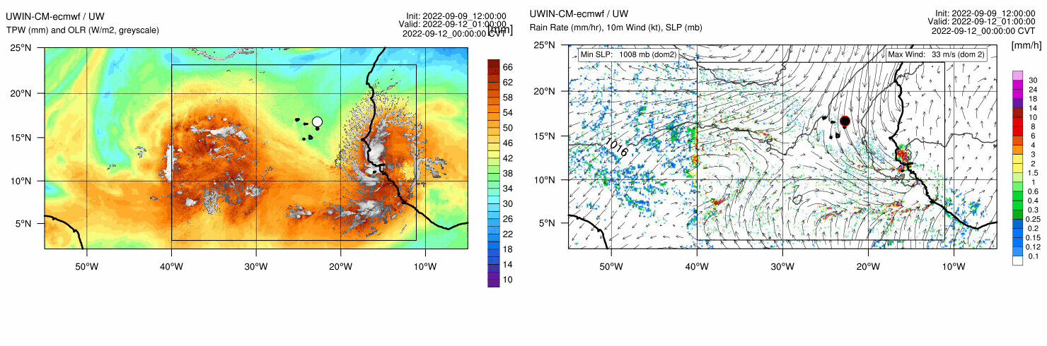
Forecast – Convection (day 2)
(Sept. 3, 2022)
TPW, OLR – UWIN-CM
10m Winds, MSLP, Rain – UWIN-CM
…

Slide 19
Forecast – Convection (day 2)
(Sept. 3, 2022)
…

Slide 20
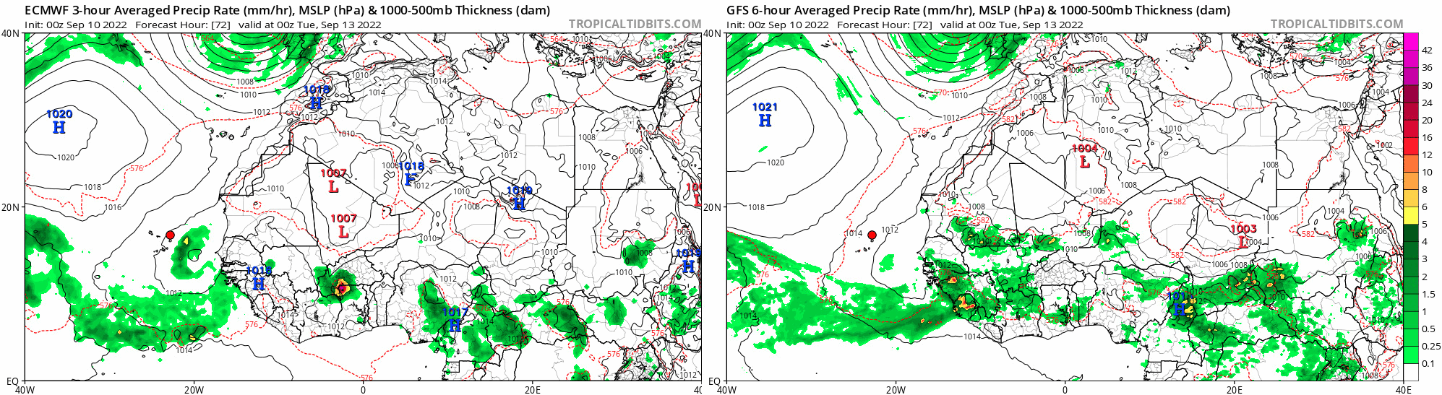
Forecast – Convection (days 3-5)
(Sept. 4 – Sept. 6, 2022)
MSLP, Rain Rate, 1000-500mb Thickness – ECMWF
MSLP, Rain Rate, 1000-500mb Thickness – GFS
…

Slide 21
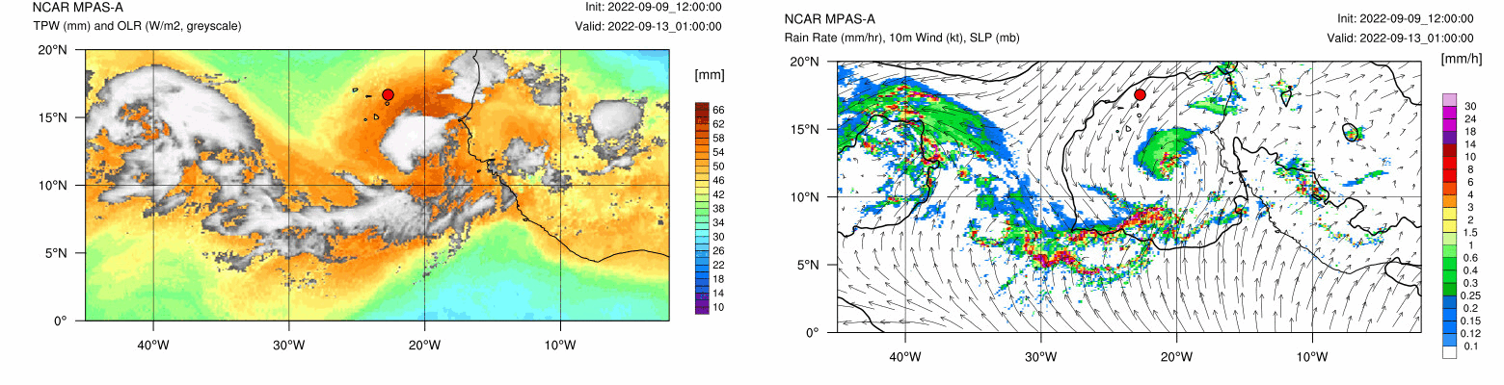
Forecast – Convection (days 3-4)
(Sept. 4 & 5, 2022)
TPW, OLR – MPAS
10m Winds, Hourly Rain Rate – MPAS
…

Slide 22
Convection – Forecast Tendency
Day 1 (Sept. XX):
Day 2 (Sept. XX):
Days 3-4 (Sept. XX – XX):

Slide 23
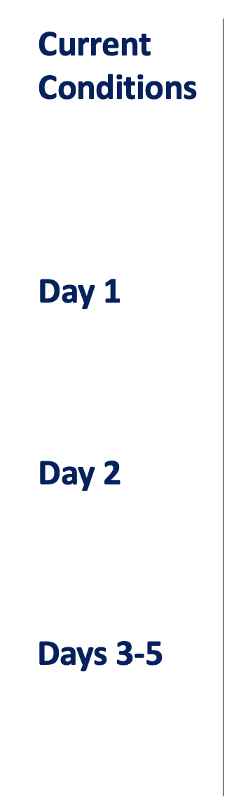
Summary
XXX.
XXX.
XXX.
XXX.

Slide 24
Sept. XX Soundings from Hotel

Slide 25
Sept. XX Soundings from Hotel

Slide 26
Sept. XX Soundings from Hotel

Slide 27
Sept. XX Soundings from Hotel

